Slide 1
Get Your Clickers!!
Properties of Water FA
SWBAT describe examples of how water supports life using the properties of water.

Slide 2
L2
I know definitions and I have memorized specific examples or explanations from the lessons, but I still need help applying the knowledge or explaining it in greater depth.
(about 60% of the points for summative assessments can be answered with this level of understanding)

Slide 3
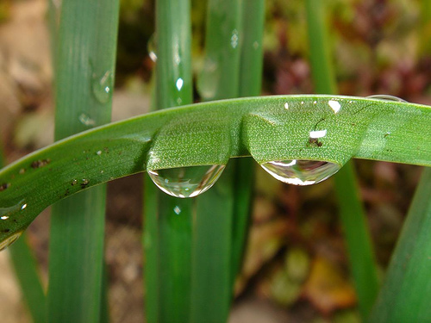
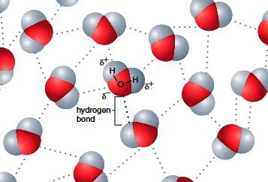
1 Water droplets form by water molecules being attracted to each other. What term best explains this behavior?
Adhesion
Cohesion
Solubility
Magnetism
encyclopedia.lubopitko-bg.com

Slide 4
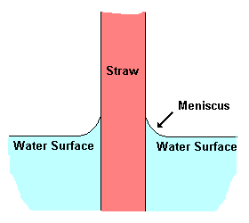
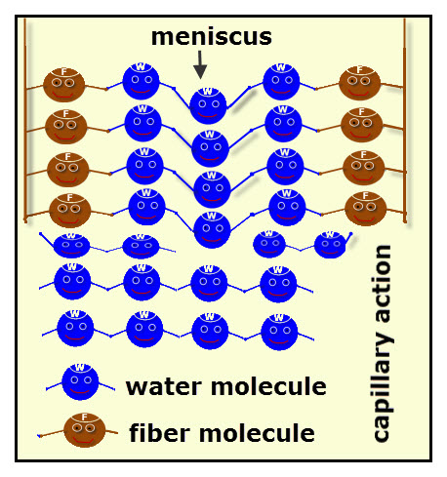
2 Which property of water allows water to stick to the sides of the straw?
Cohesion
Adhesion
Heat capacity
Universal Solvent
Brown Straw molecules
Blue water molecules
scienceprojectideasforkids.com

Slide 5
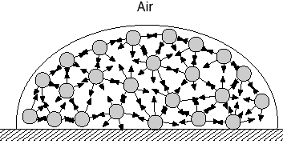
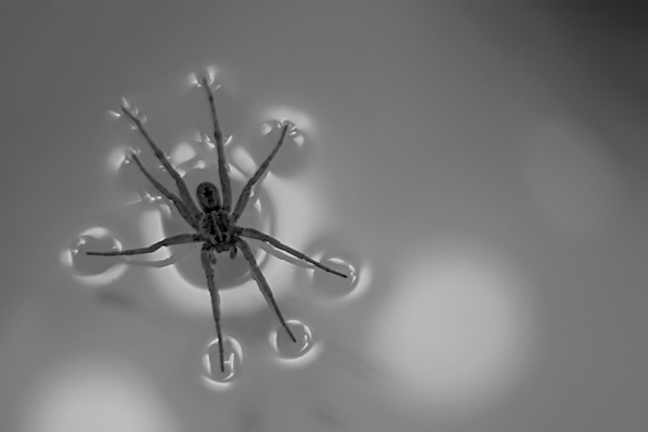
3 Which property of water allows bugs to walk on water?
Adhesion
Surface tension
Heat capacity
defneapul-cive1170.wikispaces.com
quest.nasa.gov

Slide 6
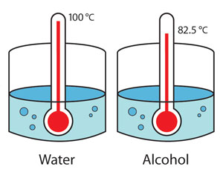
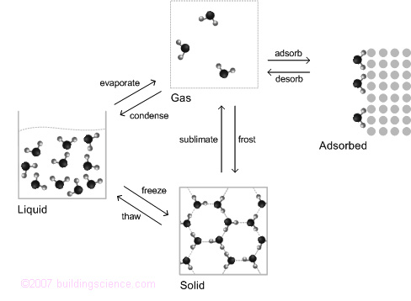
4 Water takes _______ heat to change to its gaseous state.
Large amounts of
Small amounts of
No
Boiling temperatures
Of water (left) & a polar covalent alcohol (right)
buildingscience.com
Middleschoolscience.com

Slide 7
5 What property of water allows sweat to cool the body & coastal cities to have more stable temperatures than inland cities?
High heat capacity of 1.0 calories/gº C
Neutral pH of 7
Surface tension and capillary action
Living Solvent of polar covalent & ionic compounds
Very helpful animation to explain:
http://www.hk-phy.org/contextual/heat/tep/temch/island_e.htm http://www.abpischools.org.uk/page/modules/skin/skin3.cfm

Slide 8
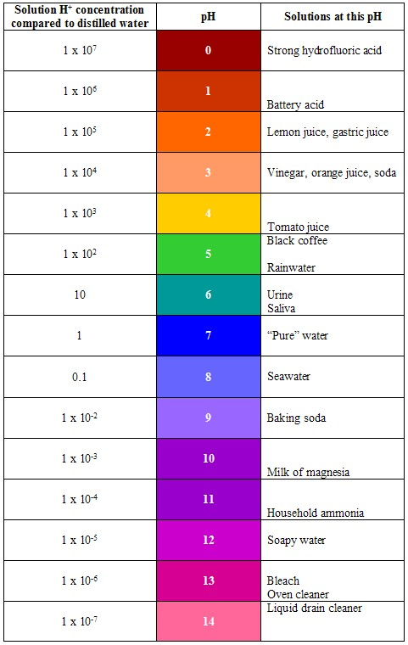
6 A solution with a pH of 3 is
Acidic
Basic
Neutral

Slide 9
7 A solution with a pH of 8 is
Acidic
Basic
Neutral

Slide 10
L 3
I know definitions and have memorized examples or explanations from lessons, and I can apply this knowledge to solving problems or can explain concepts in different or more in-depth ways.
About 30% of the points on the summative assessment require this level of understanding.

Slide 11
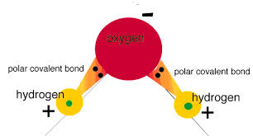
8 Water is a polar molecule because
It shares electrons equally between oxygen and hydrogen
It shares electrons unequally between oxygen and hydrogen
It freezes at zero degrees Celsius
It forms ionic bonds with other water molecules

Slide 12
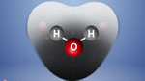
9 Which side of the water molecule has a slight negative charge?
Oxygen side
Hydrogen side
Darker grey shading shows higher electron density around nuceli

Slide 13
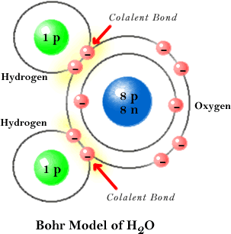
10 What type of bond exists where the red arrows are pointing?
Ionic
Covalent
Metallic
Hydrogen

Slide 14
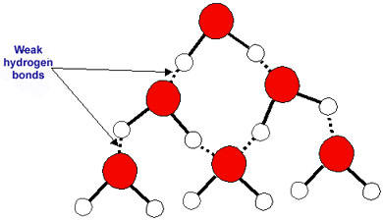
11 Water molecules form what type of bonds with each other?
Covalent bonds
Metallic bonds
Ionic bonds
Hydrogen bonds
These weak bonds
saburchill.com

Slide 15
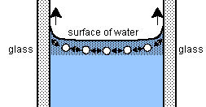
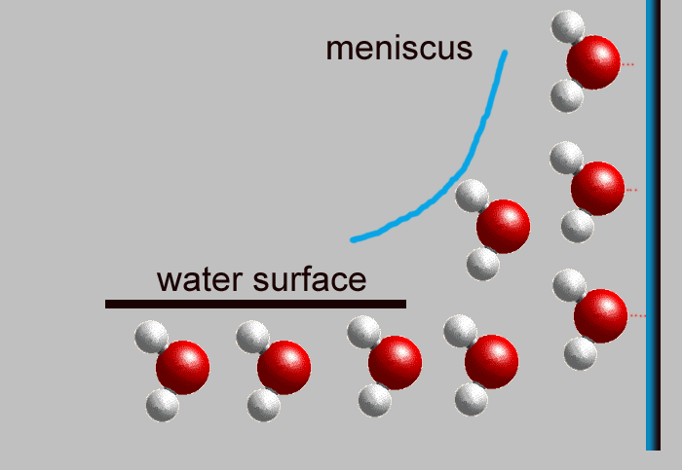
12 Surface tension and capillary action occur in water because it
is very dense
is nonpolar
has ionic bonds
has hydrogen bonds
davidlnelson.md msnucleus.org

Slide 16
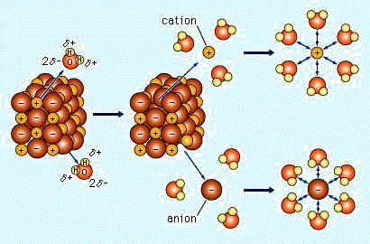
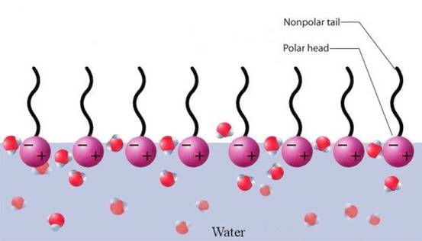
13 What kinds of substance can dissolve in water?
Hydrophobic/nonpolar covalent molecules & ions
Hydrophilic/polar covalent molecules & ions
Hydrophilic/nonpolar covalent molecules & ions
Hydrophobic/polar covalent molecules & ions
http://chsweb.lr.k12.nj.us/mstanley/outlines/waterap/water.html newdirections.com.au

Slide 17
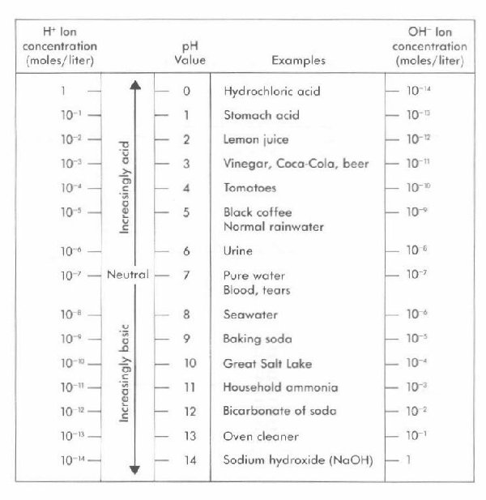
14 Which of the following is true for neutral solution?
H⁺ is greater than OH⁻
OH⁻ is greater than H⁺
H⁺ is equal to OH⁻

Slide 18
15 Which is a basic solution?
H⁺ is greater than OH⁻
OH⁻ is greater than H⁺
H⁺ is equal to OH⁻

Slide 19
Level 4
I can explain and apply the level 2 knowledge in even more sophisticated ways than I was taught in class, or I can use it to evaluate evidence or to make predictions about a related concept.
About 10% of points on a summative assessment require this level of understanding.

Slide 20
16 A solution with a pH of 3 is how many times more acidic than a solution with a pH of 5?
2 times
10 times
20 times
100 times
20,000 times

Slide 21
17 A solution with a pH of 9 is how many times more basic than a solution with a pH of 5?
4 times
100 times
1000 times
10,000 times
1 million times

Slide 22
L2
I know definitions and I have memorized specific examples or explanations from the lessons, but I still need help applying the knowledge or explaining it in greater depth.

Slide 23
1 Water droplets form by water molecules being attracted to each other. What term best explains this behavior?
Adhesion
Cohesion
Solubility
Magnetism
encyclopedia.lubopitko-bg.com

Slide 24
2 Which property of water allows water to stick to the sides of the straw?
Cohesion
Adhesion
Heat capacity
Universal Solvent
Straw molecules brown
Water molecules blue
scienceprojectideasforkids.com

Slide 25
3 Which property of water allows bugs to walk on water?
Adhesion
Surface tension
Heat capacity
defneapul-cive1170.wikispaces.com
quest.nasa.gov

Slide 26
4 Water takes _______ heat to change to its gaseous state.
Large amounts of
Small amounts of
No
Boiling temperatures
buildingscience.com
Middleschoolscience.com

Slide 27
5 What property of water allows sweat to cool the body & coastal cities to have more stable temperatures than inland cities?
High heat capacity of 1.0 calories/gº C
Neutral pH of 7
Surface tension and capillary action
Living Solvent of polar covalent & ionic compounds
Very helpful animation to explain:
http://www.hk-phy.org/contextual/heat/tep/temch/island_e.htm http://www.abpischools.org.uk/page/modules/skin/skin3.cfm

Slide 28
6 A solution with a pH of 3 is
Acidic
Basic
Neutral

Slide 29
7 A solution with a pH of 8 is
Acidic
Basic
Neutral

Slide 30
L 3
I know definitions and have memorized examples or explanations from lessons, and I can apply this knowledge to solving problems or can explain concepts in different or more in-depth ways.

Slide 31
8 Water is a polar molecule because
It shares electrons equally between oxygen and hydrogen
It shares electrons unequally between oxygen and hydrogen
It freezes at zero degrees Celsius
It forms ionic bonds with other water molecules

Slide 32
9 Which side of the water molecule has a slight negative charge?
Oxygen side
Hydrogen side
Darker grey shading shows higher electron density around nuceli

Slide 33
10 What type of bond exists where the red arrows are pointing?
Ionic
Covalent
Metallic
Hydrogen

Slide 34
11 Water molecules form what type of bonds with each other?
Covalent bonds
Metallic bonds
Ionic bonds
Hydrogen bonds
saburchill.com

Slide 35
12 Surface tension and capillary action occur in water because it
is very dense
is nonpolar
has ionic bonds
has hydrogen bonds
davidlnelson.md msnucleus.org

Slide 36
13 What kinds of substance can dissolve in water?
Hydrophobic/nonpolar covalent molecules & ions
Hydrophilic/polar covalent molecules & ions
Hydrophilic/nonpolar covalent molecules & ions
Hydrophobic/polar covalent molecules & ions
http://chsweb.lr.k12.nj.us/mstanley/outlines/waterap/water.html newdirections.com.au

Slide 37
14 Which of the following is true for neutral solution?
H⁺ is greater than OH⁻
OH⁻ is greater than H⁺
H⁺ is equal to OH⁻

Slide 38
15 Which is a basic solution?
H⁺ is greater than OH⁻
OH⁻ is greater than H⁺
H⁺ is equal to OH⁻

Slide 39
Level 4
I can explain and apply the level 2 knowledge in even more sophisticated ways than I was taught in class, or I can use it to evaluate evidence or to make predictions about a related concept.

Slide 40
16 A solution with a pH of 3 is how many times more acidic than a solution with a pH of 5?
2 times
10 times
20 times
100 times

Slide 41
17 A solution with a pH of 9 is how many times more basic than a solution with a pH of 5?
4 times
100 times
1000 times
10,000 times
1 million times

